Slide 1
RISC-V PROJECT FIR FILTER IMPLEMENTATION USING VIVADO Moving average filter
TEAM:
VISHAL SINGH-PES1UG19EC351
SRINIDHI-PES1UG20EC340

Slide 2
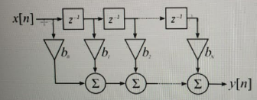
What is FIR Filter?
FIR (Finite Impulse Response) filter is a finite-length unit impulse response filter, also known as a non-recursive filter, which is the most basic element in a digital signal processing system. It can guarantee arbitrary amplitude-frequency characteristics while having strict linear phase-frequency characteristics, and its unit sampling response is finite, so the filter is a stable system. Therefore, FIR filters are widely used in communication, image processing, pattern recognition, and other fields.
Signal flow graph for direct form realisation

Slide 3
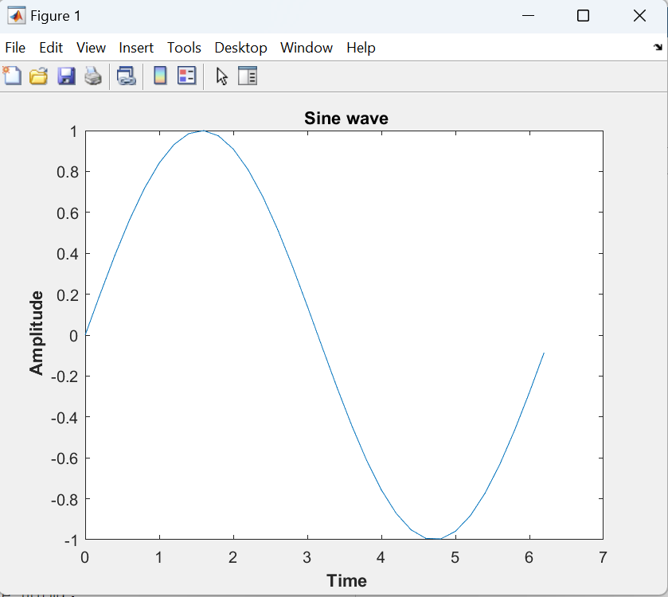
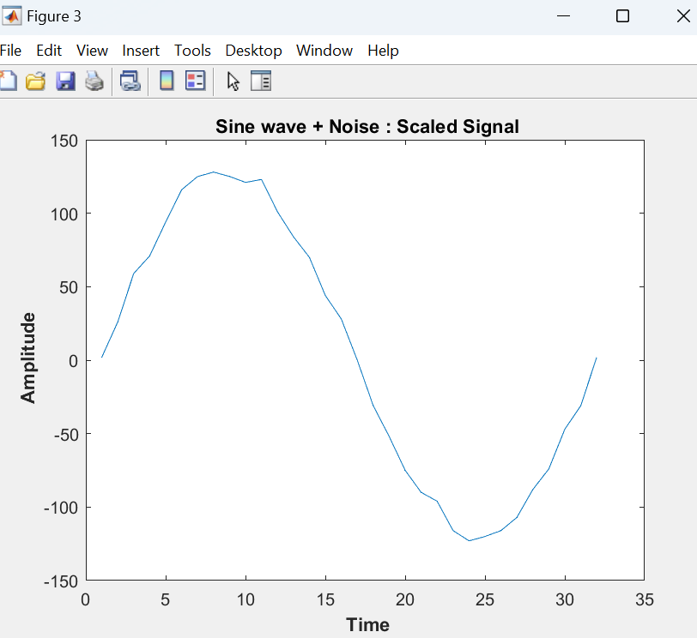
IMPLEMENTATION:
First we generate a sinusoid wave using matlab code.
We add noise to that resulting in a noisy wave
We take corresponding binary data of this noisy image and import that file to vivado to apply fir filter to the noisy image to smoothen it.

Slide 4
MATLAB CODE FOR GENERATING NOISY WAVE:
% Generate a sine wave
close all; clear all;
fs = 5;
Amp = 1;
t = 0:1/fs:2*pi; % time vector
sine_wave = Amp*sin(t);
figure();
plot(t, sine_wave);
xlabel('\bf Time');
ylabel('\bf Amplitude');
title('\bf Sine wave');
% Add a noise
a = 0.1; % upper limit
b = 0; % lower limit
noise = (b-a).*rand(length(sine_wave),1) + a; noise = noise';
sine_noise = (sine_wave + noise);
sine_norm = sine_noise / max(abs(sine_noise));
figure();plot(1:length(sine_norm), sine_norm);
xlabel('\bf Time');
ylabel('\bf Amplitude');
title('\bf Sine wave + Noise');

Slide 5
% Impulse
impulse = [zeros(1,15), 1, zeros(1,30)];
stem(impulse)
% Convert from real to integers
total_wordlength = 16;
scaling = 7;
sine_noise_integers = round(sine_norm.*(2^scaling));
figure();plot(1:length(sine_noise_integers), sine_noise_integers);
xlabel('\bf Time');
ylabel('\bf Amplitude');
title('\bf Sine wave + Noise : Scaled Signal');
% Convert from integers to binary
sine_noise_in_binary_signed = dec2bin(mod((impulse),2^total_wordlength),total_wordlength);
yy = cellstr(sine_noise_in_binary_signed);
fid = fopen('impulse.data', 'wt');
fprintf(fid, '%8s \n', yy{:});
disp('text file for signal finished');

Slide 6
VERILOG CODE:
`timescale 1ns / 1ps
module FIR_Filter(clk, reset, data_in, data_out);
parameter N = 16;
input clk, reset;
input [N-1:0] data_in;
output reg [N-1:0] data_out;
wire [5:0] b0 = 6'b100000;
wire [5:0] b1 = 6'b100000;
wire [5:0] b2 = 6'b100000;
wire [5:0] b3 = 6'b100000;
wire [N-1:0] x1, x2, x3;
DFF DFF0(clk, 0, data_in, x1); // x[n-1]
DFF DFF1(clk, 0, x1, x2); // x[x[n-2]]
DFF DFF2(clk, 0, x2, x3); // x[n-3]
// Multiplication
wire [N-1:0] Mul0, Mul1, Mul2, Mul3;

Slide 7
assign Mul0 = data_in * b0;
assign Mul1 = x1 * b1;
assign Mul2 = x2 * b2;
assign Mul3 = x3 * b3;
// Addition operation
wire [N-1:0] Add_final;
assign Add_final = Mul0 + Mul1 + Mul2 + Mul3;
// Final calculation to output
always@(posedge clk)
data_out <= Add_final;
endmodule
module DFF(clk, reset, data_in, data_delayed);
parameter N = 16;
input clk, reset;
input [N-1:0] data_in;
output reg [N-1:0] data_delayed;
always@(posedge clk, posedge reset)
begin
if (reset)

Slide 8
data_delayed <= 0;
else
data_delayed <= data_in;
end
endmodule
TEST BENCH CODE:
module FIR_TB;
parameter N = 16;
reg clk, reset;
reg [N-1:0] data_in;
wire [N-1:0] data_out;
FIR_Filter inst0(clk, reset, data_in, data_out);
// input sine wave data
initial
$readmemb("signal.data", RAMM);

Slide 9
reg [N-1:0] RAMM [31:0];
// create a clock
initial
clk = 0;
always
#10 clk = ~ clk;
// Read RAMM data and give to design
always@(posedge clk)
data_in <= RAMM[Address];
// Address counter
reg [4:0] Address;
initial
Address = 1;
always@(posedge clk)
begin
if (Address == 31)
Address = 0;
else
Address = Address + 1;
end
endmodule

Slide 10
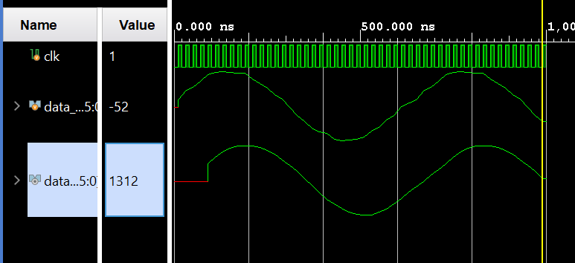
OUTPUT:
INPUT NOISY SIGNAL
FILTERED OUTPUT

